Slide 1


Doctors HealthCare Plans, Inc. - 2025
Provider Health Equity Training

Slide 2
Purpose
The purpose of this training is to share key elements of Doctor’s HealthCare Plans, Inc. (DHCP) Health Equity Plan (HEP) and how they contribute to our ongoing growth by fostering a community rooted in Diversity, Equity, and Inclusion.
By the end of this training, you will understand:
  The definitions of Health Equity, Health Inequity, and Health Disparity, and how these concepts influence individuals and their well-being.
  The impact of Social Determinants of Health (SDOH) on the health of individuals and our community.
  The actions DHCP is taking to identify, mitigate, and address potential health disparities and inequalities.

Slide 3
Advanced Care Planning (ACP)
Aligning with CMS and HHS
The United States has made progress towards improving health care quality, but well-documented disparities persist for members of racial and ethnic communities, people with disabilities, members of the LGBTQ+ community, individuals with limited English proficiency, members of rural communities, and persons otherwise adversely affected by persistent poverty or inequality. ^{1,2,3}
DHCP Health Equity Plan has been created in a manner that aligns with the HHS and CMS initiatives that seeks to achieve health equity and reduce disparities among minority and the underserved populations. This includes the Health People 2030 Framework, ⁴ which establishes the foundational principle that “achieving health and well-being requires eliminating health disparities, achieving health equity, and attaining health literacy.”
References:
1. Health Equity Considerations and Racial and Ethnic Minority Groups. Centers for Disease Control and Prevention. Published February 11, 2020. https://www.cdc.gov/coronavirus/2019-ncov/community/health-equity/race-ethnicity.html
2. Disability and Health. HealthyPeople.gov. https://health.gov/healthypeople/objectives-and-data/browse-objectives/people-disabilities
3. Krahn GL, Walker DK, Correa-De-Araujo R. Persons with disabilities as an unrecognized health disparity population. Am J Public Health. 2015;105 Suppl 2(Suppl 2):S198-S206. doi:10.2105/AJPH.2014.302182
4. Healthy People 2030. U.S. Department of Health and Human Services Office of Disease Prevention and Health Promotion. https://health.gov/healthypeople
What is it?
  A voluntary, face-to-face service (telehealth also counts), between a physician or other qualified health care professional (QHP) and a patient, family member, caregiver or surrogate to discuss the patient’s health care wishes if they become unable to make their own medical decisions.
Purpose
  To help adults at any age or stage of health understand and share their personal values, life goals and preferences regarding future medical care. It is not a single decision, it is a process that involves a variety of steps.

Slide 4


DHCP Framework for Health Equity
Consistent with CMS’s and Healthy People’s 2030 Framework for Health Equity, the DHCP Health Equity Plan sets priorities to strengthen infrastructure for assessment, create synergies across health care systems, drive structural change, and identify and work to eliminate barriers to benefits, services, and coverage.

Slide 5
DHCP Health Equity Priorities
Consistent with CMS priorities, the DHCP Health Equity Plan’s Top 5 priorities include:
Priority 1: Expand the collection, reporting, and analysis of standardized Health Equity related member and provider data.
Priority 2: Assess causes of disparities within the plan, and address inequities in policies and operations to close gaps.
Priority 3: Build capacity of the plan and workforce, including our network providers, to reduce health and health care disparities.
Priority 4: Advance language access, health literacy, and provision of culturally appropriate services specific and unique to the population we serve.
Priority 5: Increase all forms of accessibility to health care services and coverage.
For additional information related to the above priorities and DHCP related initiatives, please refer to the Plan’s Health Equity Program located at www.doctorshcp.com.

Slide 6
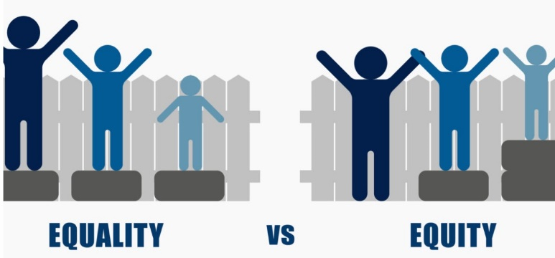
Health Equity, Disparities & Inequalities
Health Equity | Health Disparities | Health Inequities
The attainment of the highest level of health for all people, where everyone has a fair and just opportunity to attain their optimal health regardless of race, ethnicity disability, sexual orientation, gender identity, socioeconomic status. geography, preferred language, and other factors that affect access to care and health outcomes. | Preventable differences in the burden of disease, injury, violence, or opportunities to achieve optimal health, health quality, or health outcomes that are experienced by underserved populations. | Systematic differences in health outcomes. They are differences in health status or in the distribution of health resources between different population groups, arising from the social conditions in which people are born, grow, live, work and age.
Social Determinants of Health (“SDOH”) are the conditions in the environments where people are born, live, learn, work, play, worship, and age that affect a wide range of health, functioning, and quality-of-life outcomes and risks.
  References:
  www.cms.gov/files/document/health-equity-fact-sheet.pdf
  www.cdc.gov/aging/disparities
  https://health.gov/healthypeople/priority-areas/social-determinants-health

Slide 7
Underserved Communities
The term “underserved communities” refers to populations sharing a particular characteristic, including geographic communities that have been systematically denied a full opportunity to participate in aspects of economic, social, and civic life, as exemplified in the definition of “equity.” This includes members of racial and ethnic communities, people with disabilities, members of the lesbian, gay, bisexual, transgender, and queer (LGBTQ+) community, individuals with limited English proficiency, members of rural communities, and persons otherwise adversely affected by persistent poverty or inequality.
The Department of Health and Human Services (HHS) characterizes underserved, vulnerable and special needs populations as communities that include members of minority populations or individuals who have experienced health disparities, which are listed below:
    Latino, African American and AI/AN populations
    Refugees
    Individuals with limited English proficiency (LEP)
    Young adults and postsecondary graduating students who do not have health coverage options through a parent’s plan, student plan or employer plan
    New mothers and women with children
    Individuals with disabilities
    Medicaid-eligible consumers who are not enrolled in coverage despite being eligible for Medicaid

Slide 8
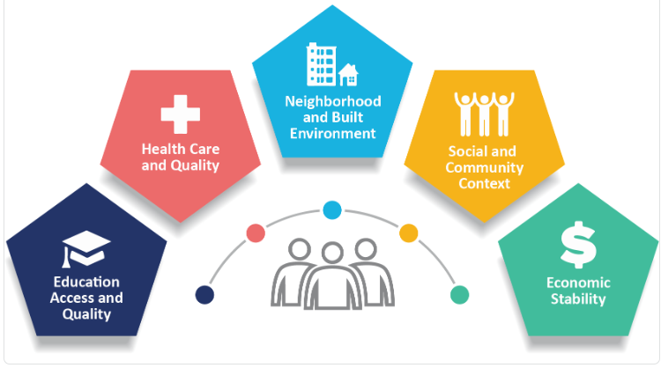
Advanced Care Planning (ACP)
Social Determinants of Health Overview
What Impacts Our Health?
Our health is determined in part by the:
    Access to social and economic opportunities
    Resources and supports available in our homes, neighborhoods, and communities
    Quality of our schooling
    Safety of our workplaces
    Cleanliness of our water, food, and air
    Nature of our social interactions and relationships
The conditions in which we live explain in part why some Americans are healthier than others and why Americans in general are not as healthy as they could be.
Factors in SDOH
SDOH are complex, integrated, and overlapping social structures
and economic systems that are responsible for most health inequities.
The factors involved are shown in the picture.
https://www.cdc.gov/public-health-gateway/php/about/social-determinants-of-health.html?CDC_AAref_Val=https://www.cdc.gov/publichealthgateway/sdoh/index.html
What is it?
  A voluntary, face-to-face service (telehealth also counts), between a physician or other qualified health care professional (QHP) and a patient, family member, caregiver or surrogate to discuss the patient’s health care wishes if they become unable to make their own medical decisions.
Purpose
  To help adults at any age or stage of health understand and share their personal values, life goals and preferences regarding future medical care. It is not a single decision, it is a process that involves a variety of steps.

Slide 9
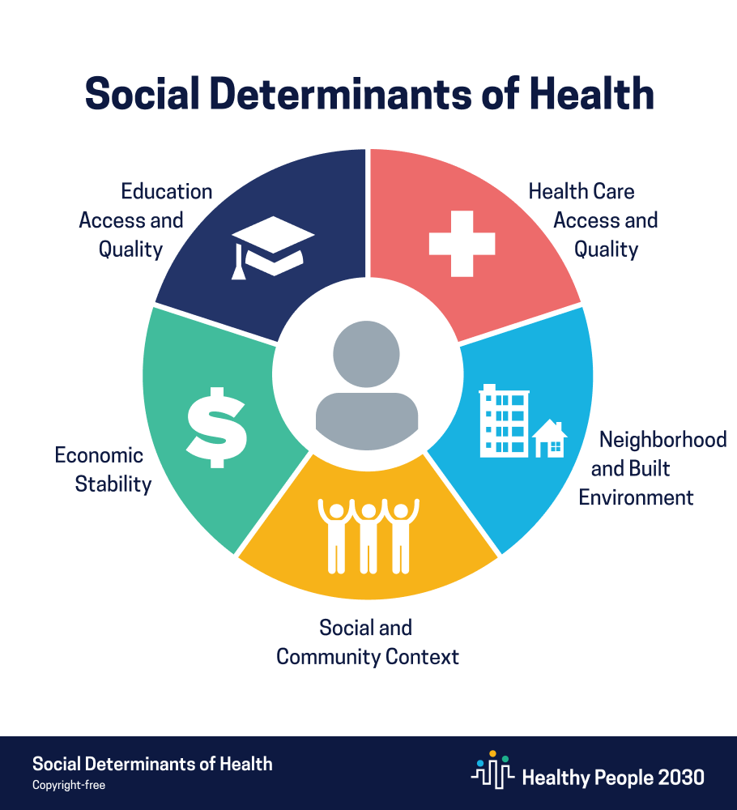
Advanced Care Planning (ACP)
Social Determinants of Health Overview
What Impacts Our Health?
Our health is determined in part by the:
    Access to social and economic opportunities
    Resources and supports available in our homes, neighborhoods, and communities
    Quality of our schooling
    Safety of our workplaces
    Cleanliness of our water, food, and air
    Nature of our social interactions and relationships
The conditions in which we live explain in part why some Americans are healthier than others and why Americans in general are not as healthy as they could be.
What is it?
  A voluntary, face-to-face service (telehealth also counts), between a physician or other qualified health care professional (QHP) and a patient, family member, caregiver or surrogate to discuss the patient’s health care wishes if they become unable to make their own medical decisions.
Purpose
  To help adults at any age or stage of health understand and share their personal values, life goals and preferences regarding future medical care. It is not a single decision, it is a process that involves a variety of steps.

Slide 10
Social Determinates of Health (SDOH) -5 Domains
1. Economic Stability
  Challenges: Lack of steady employment and sufficient income impacts the ability to afford essentials like healthy food, healthcare, and housing, leading to health disparities.
  Interventions: Employment programs, career counseling, and support for basic needs (food, housing, healthcare) can reduce poverty and improve health.
2. Education Access and Quality
  Challenges: Children from low-income families, with disabilities, or facing discrimination often struggle academically, are less likely to graduate, and are more prone to health issues.
  Interventions: Supporting children in school and providing financial assistance for college can lead to long-term health benefits.
3. Health Care Access and Quality
  Challenges: Uninsured individuals often lack access to primary care and necessary health services, leading to untreated conditions and delayed care.
  Interventions: Increasing insurance coverage, improving access to healthcare providers, and enhancing digital health literacy can improve health outcomes.
4. Neighborhood and Built Environment
  Challenges: Living in unsafe neighborhoods with environmental risks contributes to health problems, particularly among racial/ethnic minorities and low-income populations.
  Interventions: Policy changes, adding sidewalks, and ensuring safe biking paths can enhance community health and safety.
5. Social and Community Context
  Challenges: Relationships and interactions within one’s community can significantly impact health. Negative environments exacerbate health risks.
  Interventions: Providing social and community support can help mitigate these challenges and promote overall well-being.

Slide 11
Advanced Care Planning (ACP)
Personal Health Literacy
Personal health literacy is the ability to use a variety of skills to access and understand health information and services in order to improve and maintain health. These skills include:
    Reading & writing
    Calculating numbers
    Communicating with health care professionals
    Using health technology
    Listening, speaking & critical analysis
    Decision-making skills
The ultimate goal for DHCP members is to:
Apply the health information rather than just understand it.
Make “well-informed” decisions rather than “appropriate” ones.
Research has shown that health literacy can:
  Increase the use of preventive health care
  Lower unneeded emergency room visits
  Lower preventable stays in the hospital and readmissions
  Lower dosing errors
  Help patients better manage their chronic conditions such as diabetes, high cholesterol, hypertension, and HIV/AIDS
  Improve health outcomes
  Enhance all six aims of quality improvement: safe, effective, patient-centered, timely, efficient, and equitable
  Increase patient satisfaction
What is it?
  A voluntary, face-to-face service (telehealth also counts), between a physician or other qualified health care professional (QHP) and a patient, family member, caregiver or surrogate to discuss the patient’s health care wishes if they become unable to make their own medical decisions.
Purpose
  To help adults at any age or stage of health understand and share their personal values, life goals and preferences regarding future medical care. It is not a single decision, it is a process that involves a variety of steps.

Slide 12
Advanced Care Planning (ACP)
Organizational Literacy
How Providers Can Help
Organizational health literacy is the degree to which organizations equitably enable individuals to find, understand, and use information and services to inform health-related decisions and actions for themselves and others.
How Providers can help:
  Incorporate SDOH questions into health assessments and refer DHCP members, with identified gaps, to DCHP Social Services Department for assistance.
  Document SDOH Gaps in member encounters utilizing appropriate ICD-10 Z codes.
  Inform members about your office telemedicine policy, assuring members are aware of the accessibility of telehealth services and are provided instructions for accessing telehealth services when needed.
  Assure that all staff provide medical care in a manner that considers the member’s race/ethnicity, language and cultural preferences which may impact/influence their health care outcomes.
  Ensure office staff have access to and undergoes cultural sensitivity training and development.
  Offer assistance with completing forms.
  When developing treatment plans, consider the member’s race, country of origin, native language, religion, mental and physical abilities, cultural beliefs, age, gender, sexual orientation and other characteristics that may impact/influence a member’s perspective on healthcare and treatment options.
  Post materials in English, Spanish and other prevalent languages to accommodate the members linguistic preference.
https://www.hrsa.gov/about/organization/bureaus/ohe/health-literacy
What is it?
  A voluntary, face-to-face service (telehealth also counts), between a physician or other qualified health care professional (QHP) and a patient, family member, caregiver or surrogate to discuss the patient’s health care wishes if they become unable to make their own medical decisions.
Purpose
  To help adults at any age or stage of health understand and share their personal values, life goals and preferences regarding future medical care. It is not a single decision, it is a process that involves a variety of steps.

